Slide 1
Quantum Scan Controller
Submitted by,
Kevin Kavalakkat

Slide 2
Objective
Coordinate a 2D scan of a translation stage
Acquire simulated quantum-sensor data at each point
Implement retry logic for hardware errors
Process and visualize scan data
Provide CLI, Jupyter, and full test coverage

Slide 3
System Architecture
CLI / Jupyter: User interface
Scan Controller: Orchestrates scan, handles retries
Device Wrappers: Simulates stage and sensor
Data Processing: Smoothing, peak detection
I/O: CSV & heatmap output
Unit Tests: Mocking for full coverage
Folder Structure is
├── qd_scan/ # Main package folder
│ ├── __init__.py
│ ├── cli.py # Command-line interface
│ ├── scan_controller.py # Main scan logic and retry handling
│ ├── sim_device_wrapper.py # Wrappers for SimStage/SimSensor
│ ├── data_processing.py # Smoothing, peak detection, etc.
│ └── io_utils.py # CSV and image saving
├── tests/
│ ├── __init__.py
│ └── test_scan_controller.py
│ └── test_data_processing.py
├── config.yaml
├── qd_scan_notebook.ipynb
├── README.md
├── requirements.txt
└── slides.pptx
CLI /
Jupyter Notebook
Scan Controller
(Retry Logic)
Data Processing
(Smoothing,Peak Detection)
Device Wrappers
(SimStage, SiimSensor)
I/O
(CSV, Heatmap)
Unit Tests
(Mocking)

Slide 4
Config & CLI
Config.yaml:
X/Y range, steps
Retry counts
Smoothing window
Logging, output files
CLI Usage: python cli.py --config config.yaml
Jupyter Notebook: Full scan, visualization, and logging

Slide 5
Device Interfaces & Retry Logic
SimStage.move_to(x, y): May raise TimeoutError
SimSensor.measure(): May return None or raise ValueError
Retry Strategy:
On failure, retry up to N times
Log error and skip if all retries fail
Start Move/Measure
Attempt Operation
(move_to or measure
Loop back to attempt
Success?
Yes
No
Record Success
Retries Left?
Yes
No
Log Error/Skip
Increment Attempt Wait (optional)

Slide 6
Data Processing & Output
SimStage
SimSensor
Raw Data: All sensor readings
Smoothing: Rolling average filter (window size from config) to reduce noise in sensor data.
Peak Detection:
Find global peak in filtered data
Local maxima above a configurable threshold are identified using scipy.signal.find_peaks
Outputs:
CSV: [x, y, raw_value, filtered_value]
Heatmap: Raw + Filtered + peaks
Scan Controller
Raw Data
Smoothing
CSV Output
Filtered Data
HeatMap Output

Slide 7
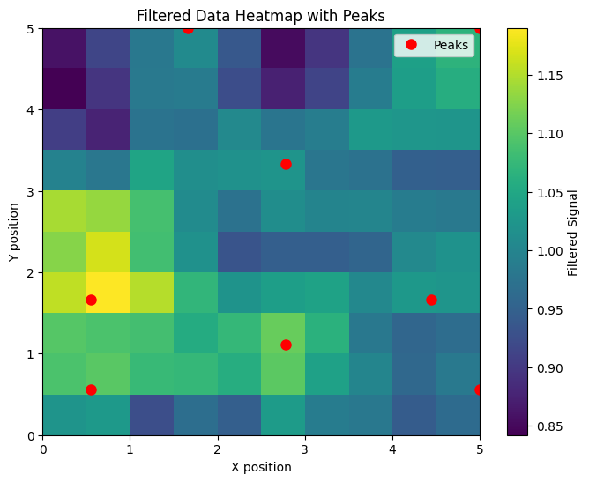
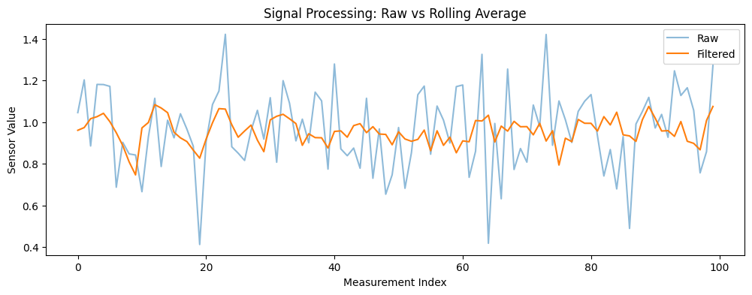
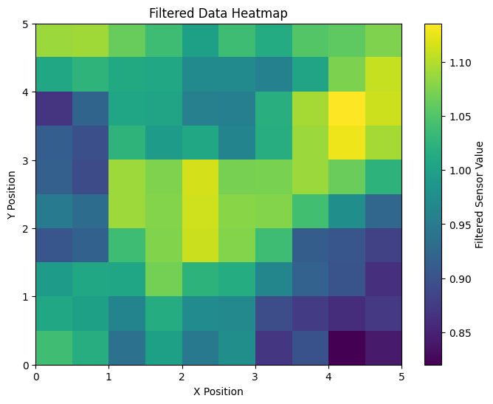
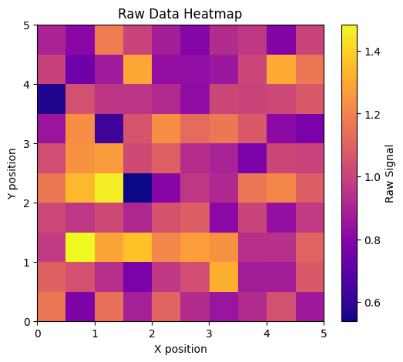
Example Results

Slide 8
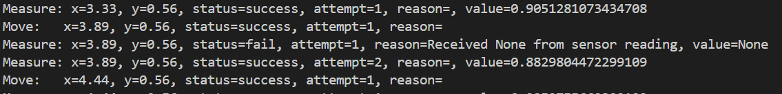
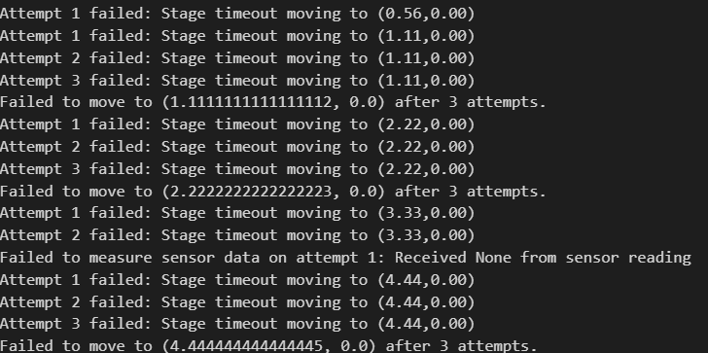

Slide 9
Testing & Automation
Unit Tests
Unit tests with pytest + mocking
Simulate hardware failures
Verify retry logic and error handling
Test smoothing and peak detection algorithms
All tests pass (pytest summary screenshot)
Scan Controller
Data Processing
Mock SimStage/Sensor
Test Smoothing,
Peak detection

Slide 10
How to Run & Extend
Setup:
pip install -r requirements.txt
Run CLI:
python cli.py --config config.yaml
Run Notebook:
Open qd_scan_notebook.ipynb, run all cells
Run Tests:
python -m pytest
Extend:
Swap in real hardware, tune config, example, sensor_fail_rate: 0.3, Add new data processing or visualization modules as needed.

Slide 11
Conclusion
Robustness:
Structured error handling and retry logic ensure reliable operation, even with simulated hardware failures
Testing:
High code coverage and continuous integration guarantee maintainable, high-quality code
Extensibility:
Modular design and clear configuration make the scan easy to adapt for new experiments or hardware

Slide 12
Future Work
Real Hardware Integration:
Connect and validate the scan controller with actual laboratory hardware for live experiments.
3D Scanning Capability:
Extend the framework to support volumetric (3D) scans for richer spatial analysis.
Advanced Analytics:
Implement machine learning for automated feature extraction and anomaly detection.
User Interface Enhancements:
Develop a GUI for interactive scan setup, monitoring, and visualization.
Scalability & Performance:
Optimize for larger scan grids and real-time data processing.
Automated Reporting:
Generate summary reports and visualizations automatically after each scan.

Slide 13
Thank you

